Slide 1
Mini Capstone Project
Gen AI for DE
Sigma DataTech Day 12

Slide 2
Day 12 —Sigma Intelligence Platform
A ₹4.72L silent disaster. Pipeline green. Dashboard wrong.
80,000 records missing. No alert fired. No one noticed for 7 hours.
Today you build the system that fixes it — in 26 seconds. Autonomously.

Slide 3

Day 12 —Sigma Intelligence Platform
WHAT YOU BUILD
Kinesis → Firehose
S3 → Snowflake
Lambda (9 tools)
CloudWatch + SNS
EventBridge trigger
THE AI LAYER
7 Bedrock Agents
MCP Server (tool discovery)
Knowledge Base — RAG
Guardrails (PII + compliance)
Amazon Nova Pro
AGENTS
Forensics → Impact → Recovery → Rollback → Hardening → Report

Slide 4
Day 12 —Sigma Intelligence Platform
The same architecture runs at PhonePe, Razorpay & CRED.
You will build it, break it, and watch AI heal it.

Slide 5
Knowledge base creation - approach
Create setup_kb.py that:
1. Reads all .md files from lab/knowledge_base/
2. Calls Bedrock Titan Embeddings (amazon.titan-embed-text-v2:0) to embed each document
3. Saves the index as knowledge_base/index.json in your S3 bucket
Then update test_knowledge_base.py to:
1. Load the index from S3
2. Embed the query using the same model
3. Do cosine similarity (numpy)
4. Return top 3 results
Refer to lab/knowledge_base/
sla_contracts/quickmart_sla.md
sla_contracts/fuelplus_sla.md
runbooks/kinesis_replay_runbook.md
data_contracts/sigma_transactions_v1.md
Attention : Avoid using AWS Open Search SERVERLESS

Slide 6
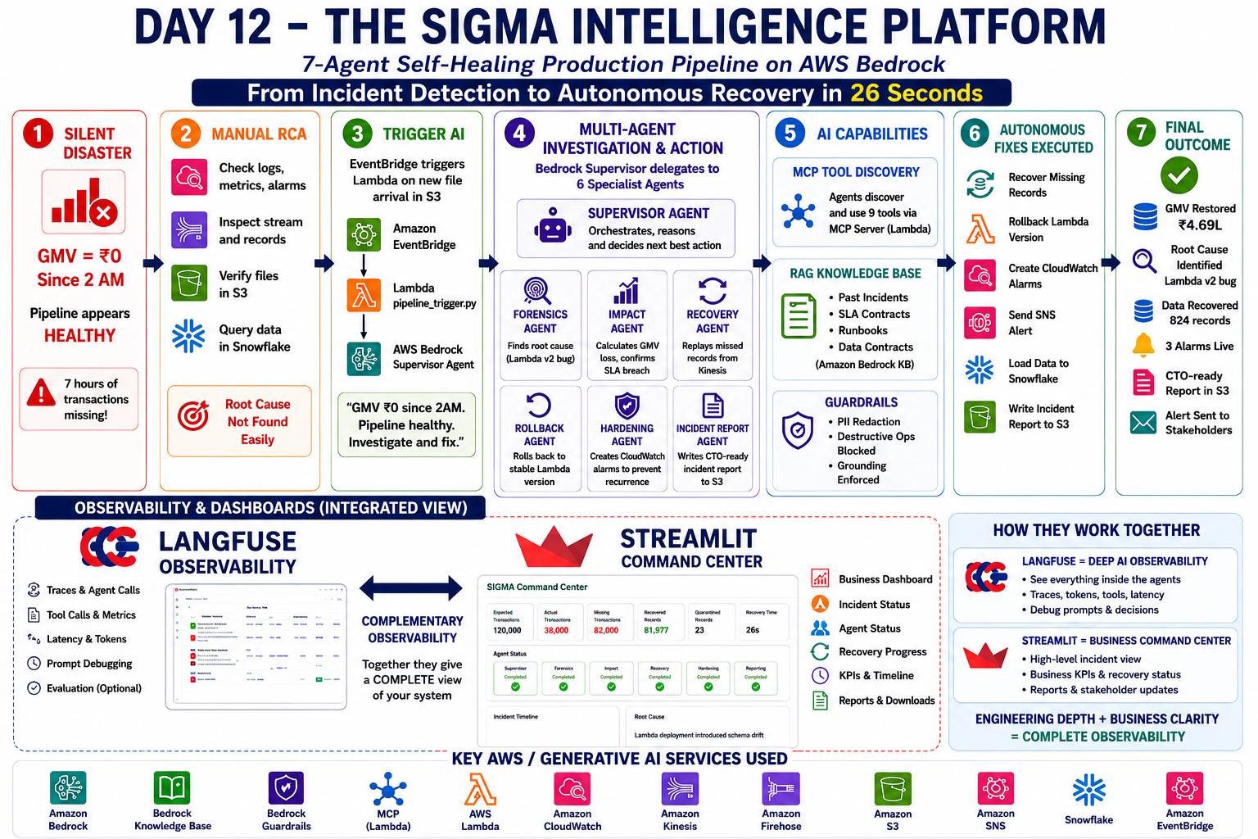

Slide 7
Two Modes to implement
Speed Runner Mode
README.md only
No hints. No steps.
Do it yourselves
2X Points
Guided Quest Mode
Implementation Guide
Every step. Every command.
Normal Points
Stretch : Implement Streamlit dashboard to gain Bonus Points

